Slide 1
Project Heart Monitor
Bassant Samy
https://github.com/BassantSamy/Heart_Monitor

Slide 2
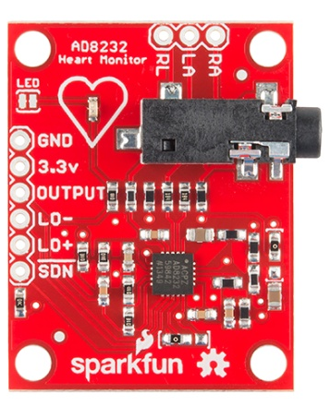
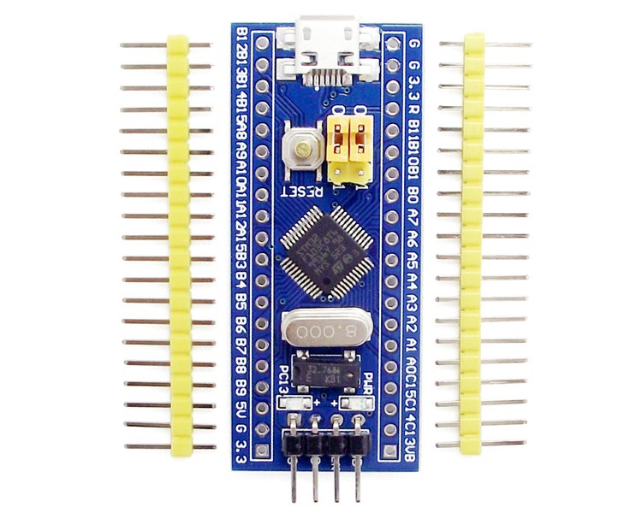
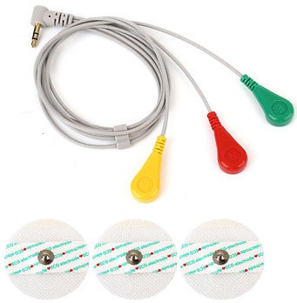

Project Architecture

Slide 3
Project Tasks
Create GUI
Send user input over UART
Set sampling Rate
Sampled Heart Signal
Constrict Sampling to one minute
Calculating BPM
Display output as graph

Slide 4
Task Division
Previous Deadline | Current Deadline
- Sampled Heart Signal - Constrict Sampling to one minute - Set Sampling Rate - Created a GUI using PySerial | - Reading Sampling Rate from user - Calculating BPM Displaying output in Form of Graph Allowed Rerunning Added Validation Optimized the code (baud rate)

Slide 5
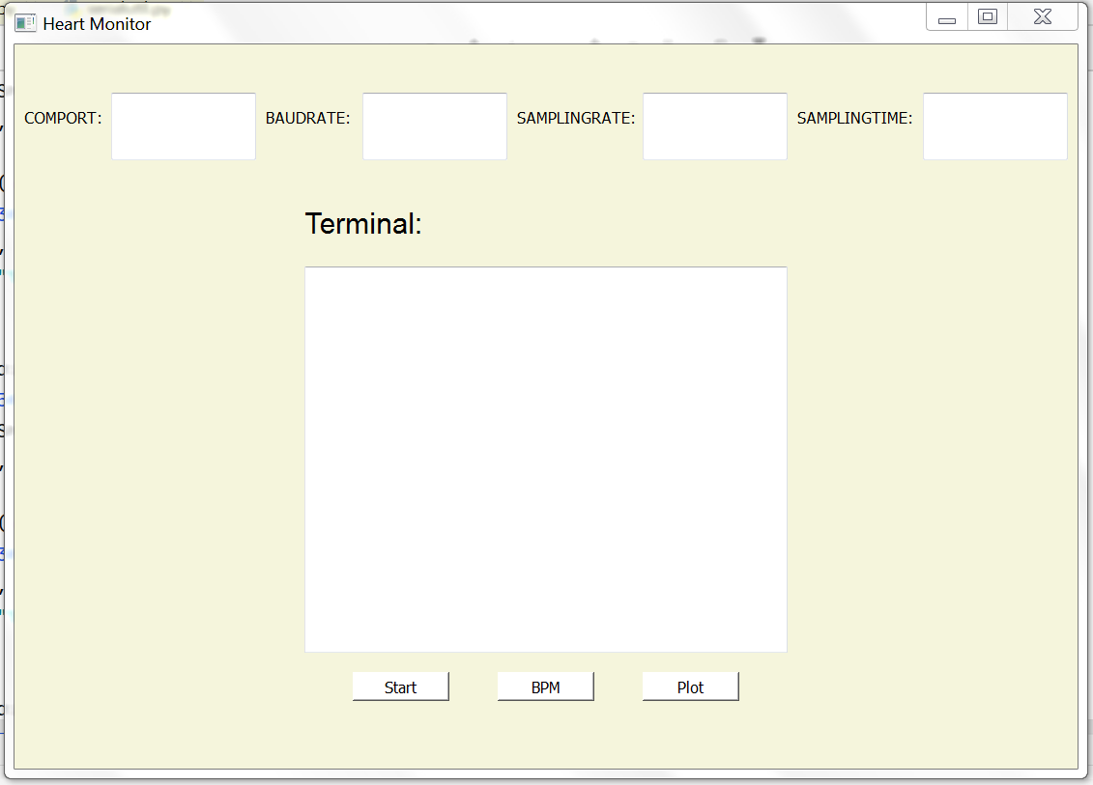
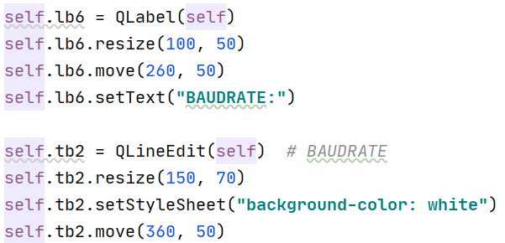
Create GUI
Using Python
Buttons
Textboxes
Labels

Slide 6
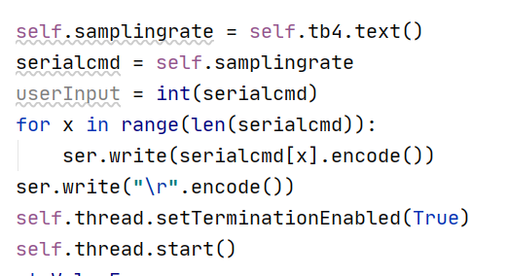
Send user input over UART
Using Pyserial
Initialize connection
Send sampling time first
Digit by digit
\r terminated
Send sampling rate next …

Slide 7
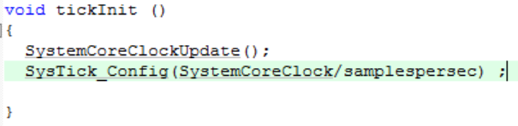
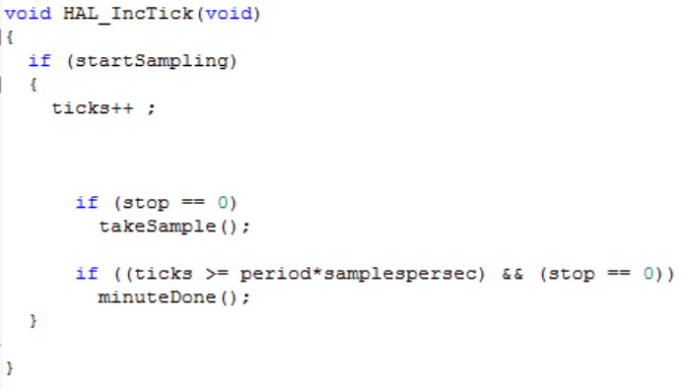
Set sampling Rate
Rx Callback
Systick Timer
Set Tick Interval
Take Sample
per Tick

Slide 8
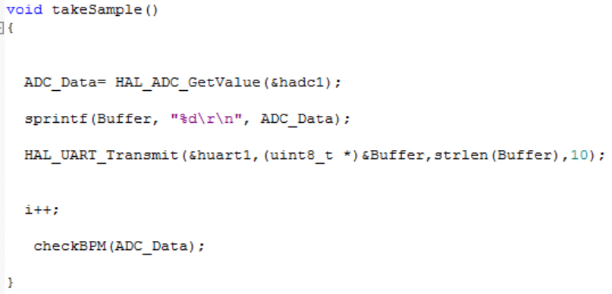
Sampled Heart Signal
On-chip ADC
Every Tick

Slide 9
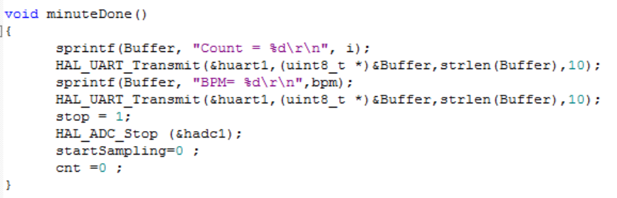
Constrict Sampling to one minute
Systick Timer
Sampling period (60)
* sampling rate

Slide 10
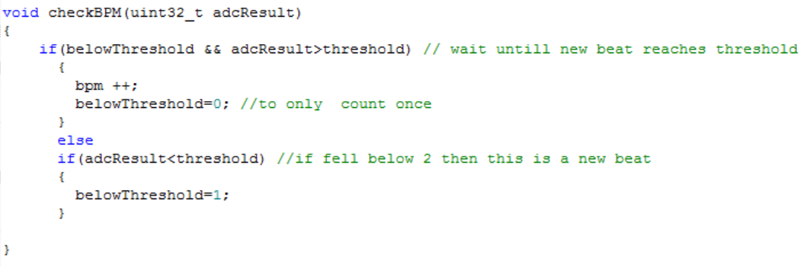
Calculating BPM
Compare adc to threshold
If counted set flag
Count beat once
Called every new adc value

Slide 11
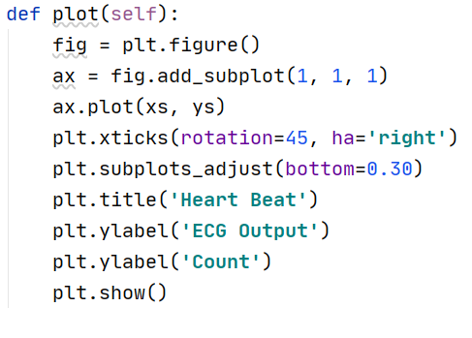
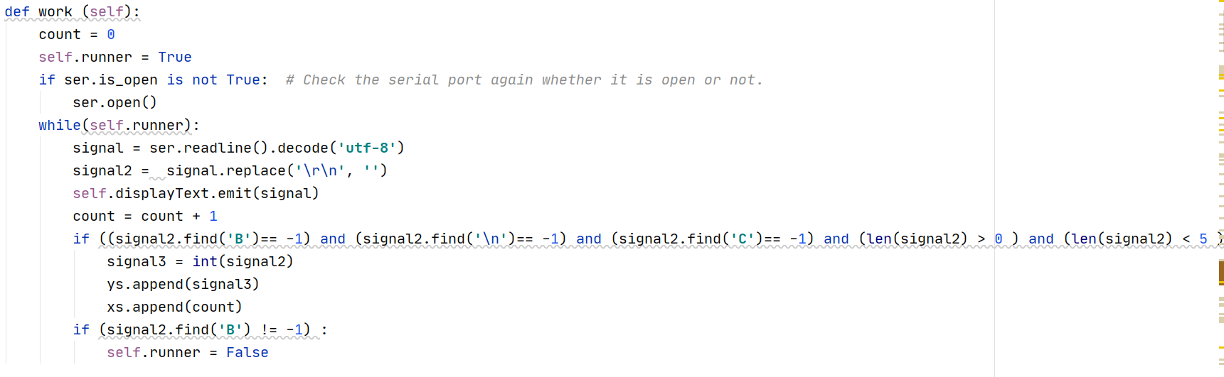
Display output as graph
Use matpoltlib
Receive data
through UART

Slide 12
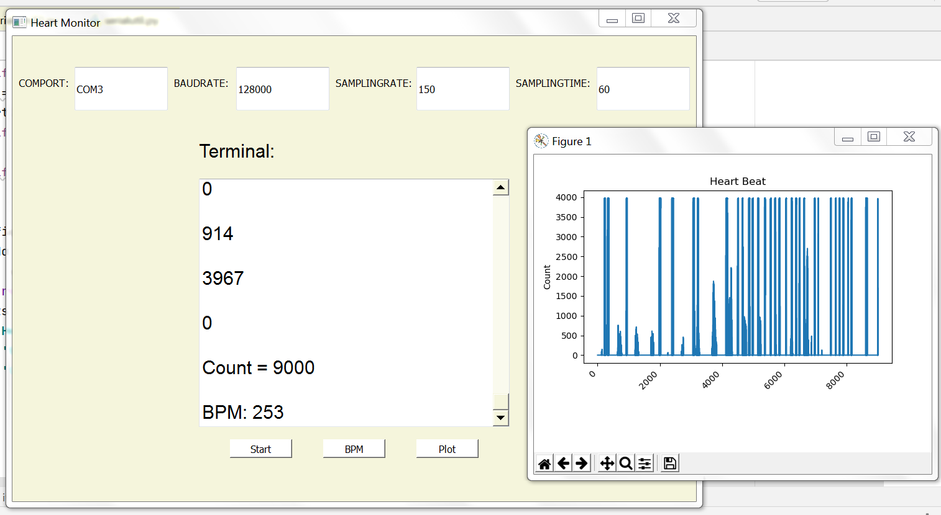
Results

Slide 13
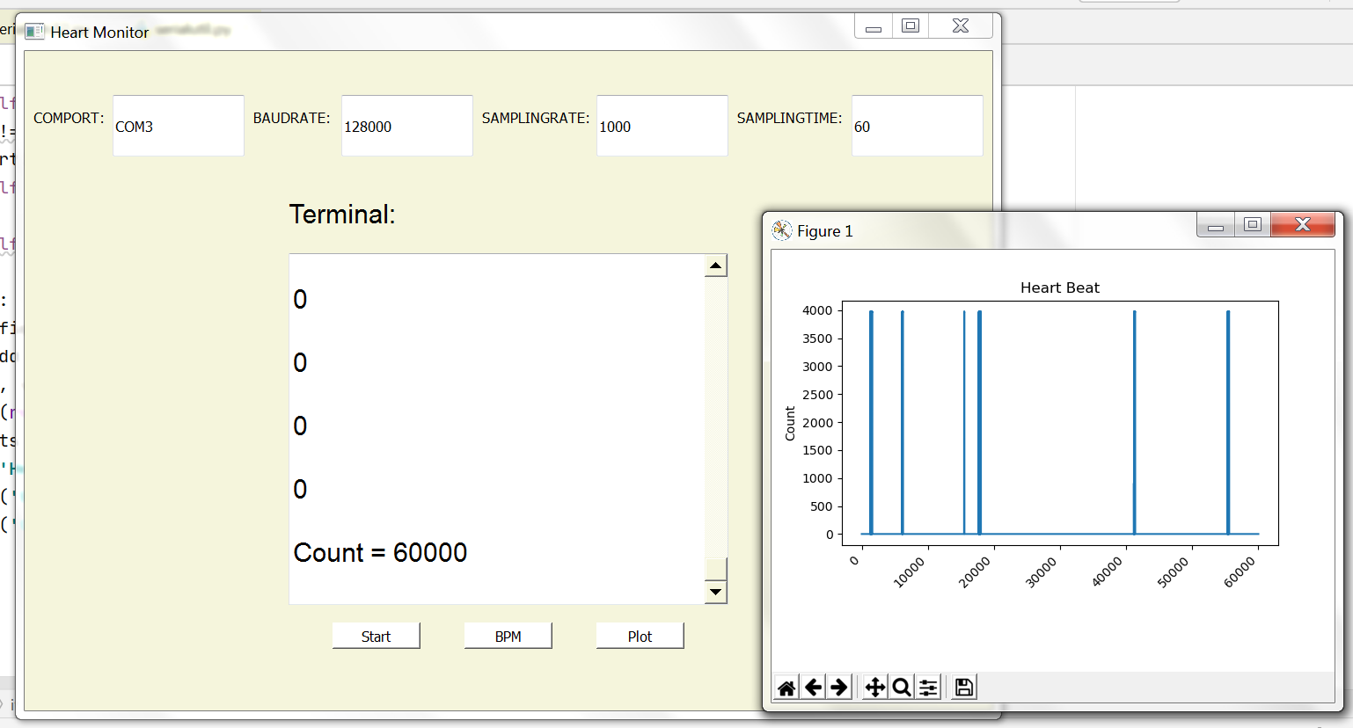
Results…

Slide 14
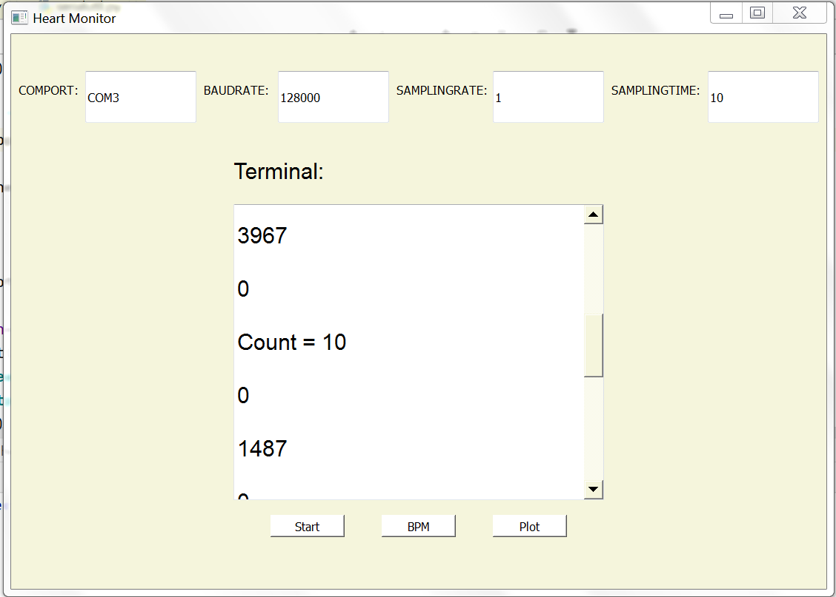
Results (Rerun)…

Slide 15
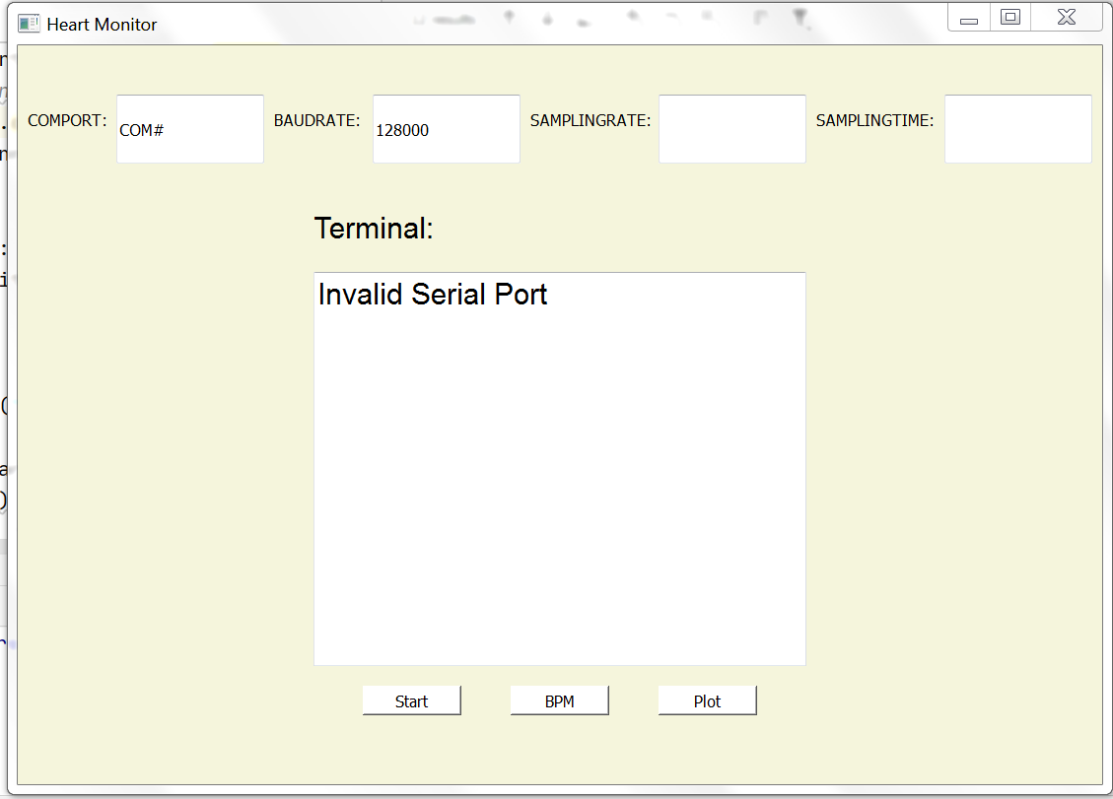
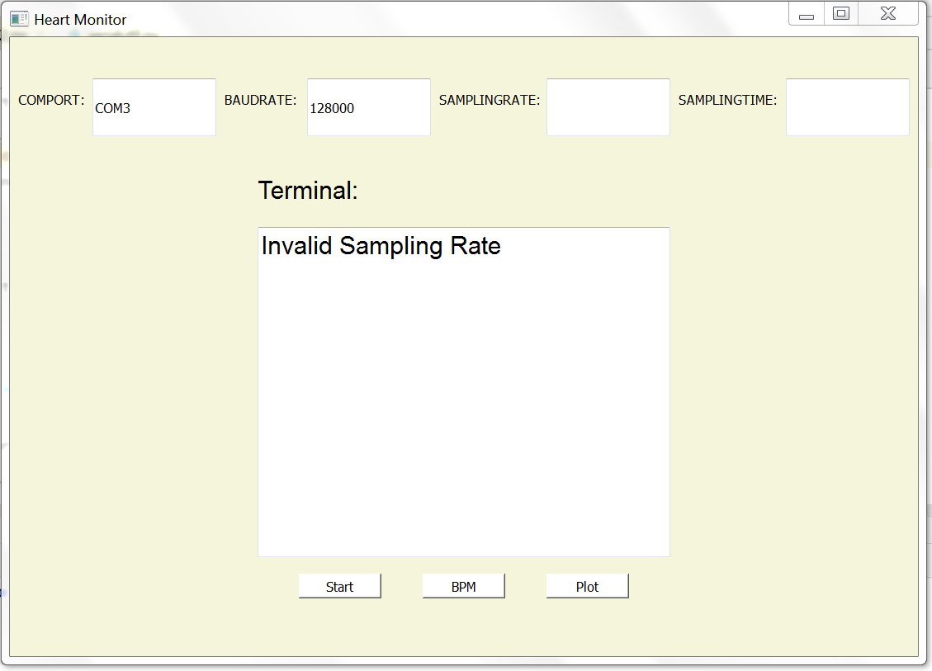
Results (Validation)…

Slide 16
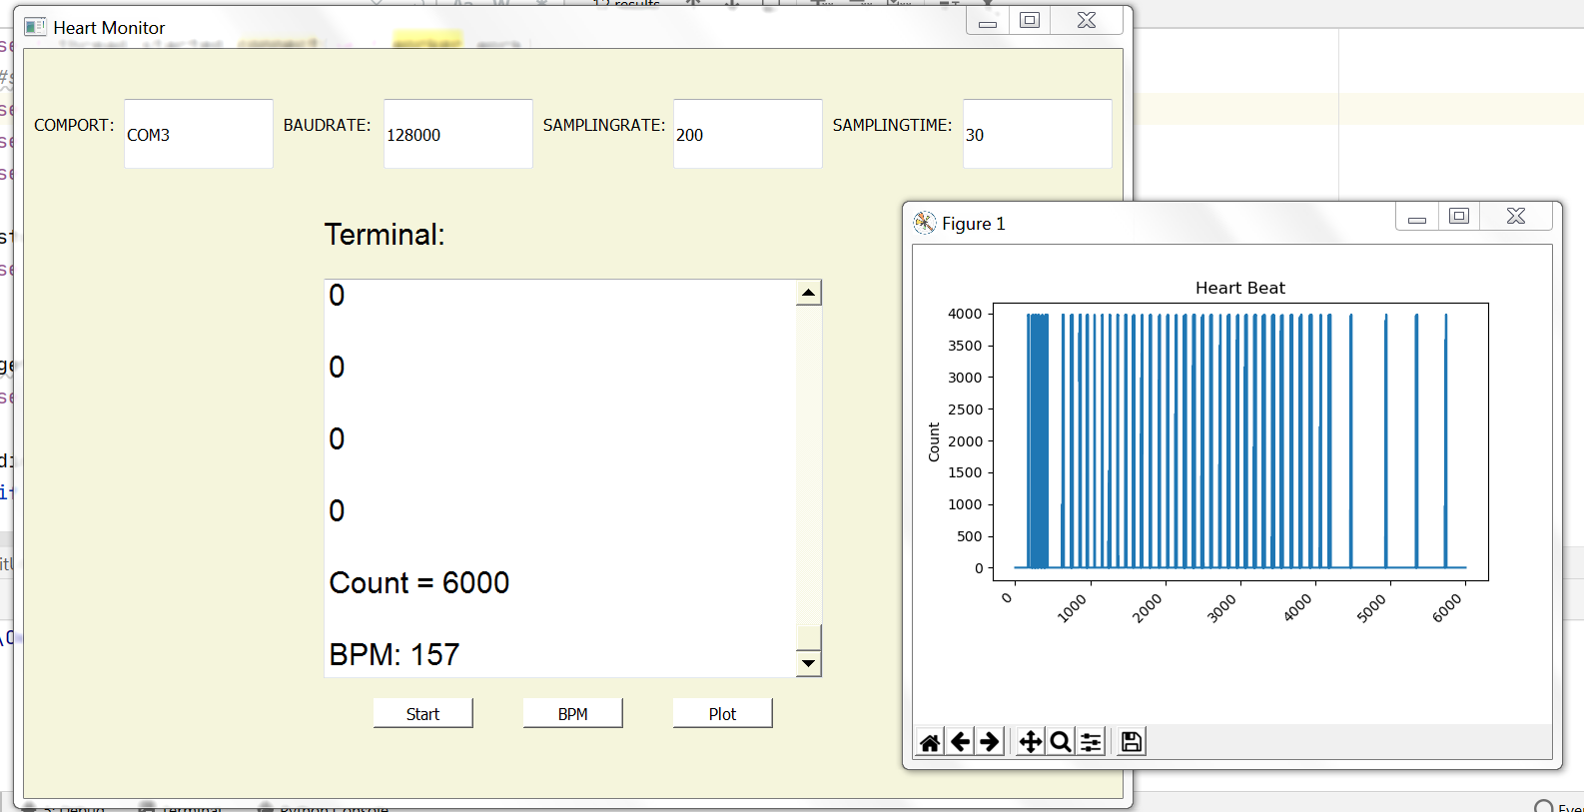
Results (Sampling Time)…

Slide 17
Thank You !!!

